Slide 1
CIS041-3 Advanced Information Technology
Advanced IT projects
Gangmin Li
(Office hours: 13:00-17:00 every Friday)

Slide 2
Advanced Information Technology
Artificial Intelligence
Cloud Computing
Machine Learning
The Internet of Things
Virtual Reality

Slide 3
Neural NLP
In the 2010s, deep neural network and machine learning became widespread in natural language processing. It form an era called Neural NLP
Traditional statistical methods give ways to Neural Networks.
Use of word embeddings to capture semantic properties of words, and an increase in end-to-end learning of a higher-level task (e.g., question answering, part-of-speech tagging and dependency parsing).
Use of deep neural Networks and deep learning-based approaches to build language models used many tasks like Natural–language generation, Question answering, Machine translation and Text summarization

Slide 4
10 Common Examples of NLP
Virtual assistants, voice assistants, or smart speakers
Online search engines
Predictive text and autocorrect
Monitor brand sentiment on social media
Sorting customer feedback
Automating processes in customer support
Chatbots
Automatic summarization
Machine translation
Natural language generation

Slide 5
Outlines
Named Entity recognition (NER)
Speech recognition - Chat box
Text Summary

Slide 6
1. Named Entity recognition (NER)

Slide 7
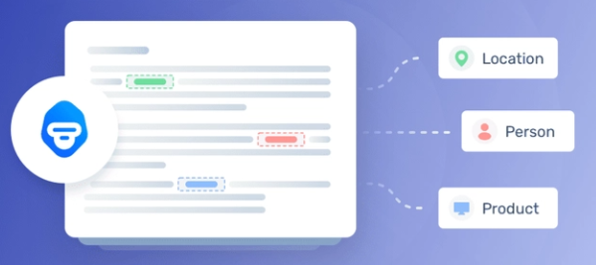
Named Entity recognition (NER)

Slide 8
Named Entity Recognition: Concept, Tools and Tutorial
https://monkeylearn.com/blog/named-entity-recognition/#:~:text=When%20we%20read%20a%20text,%E2%80%9CCompany%E2%80%9D%3A%20Facebook
https://monkeylearn.com/blog/named-entity-recognition-python/

Slide 9
Chat box

Slide 10



Slide 11
Summary
AI is a hot, debatable area particularly on the aspect of what is intelligence.
AI has achieved a great advancements (computer vision and NLP) thanks to distributed computing and Big Data.
AI in its 3rd wave and driven by advancement in ANN and Machine Learning
ANN is trying to build a biological brain on computer (with memory and computation similar to human)
ANN has three cornerstones: Architecture, Algorithms and training data. The focuse was algorithm -> architecture (connection and depth of the layers) -> data
ANN have great potential in NLP (part of human intelligence)

